Slide 1
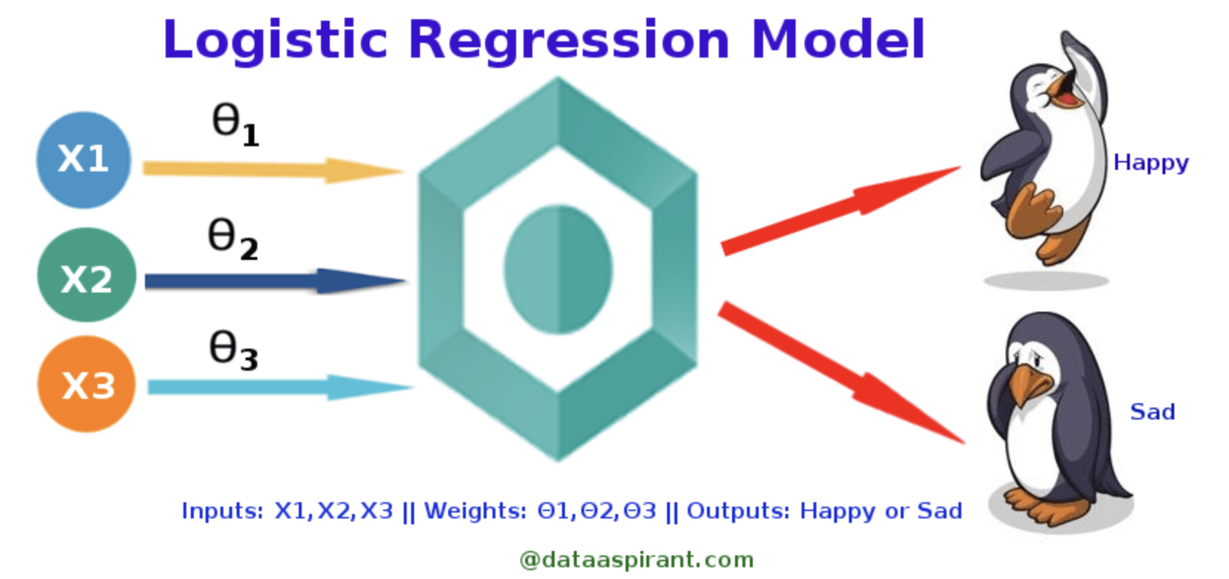

Slide 2
Logistic Regression
Prepare the data: The data should be in a format where each row represents a single observation and each column represents a different variable. The target variable (the variable you want to predict) should be binary (yes/no, true/false, 0/1).
Train the model: We teach the model by showing it the training data. This involves finding the values of the model parameters that minimize the error in the training data.
Evaluate the model: The model is evaluated on the held-out test data to assess its performance on unseen data.
Use the model to make predictions: After the model has been trained and assessed, it can be used to forecast outcomes on new data.
https://www.analyticsvidhya.com/blog/2021/08/conceptual-understanding-of-logistic-regression-for-data-science-beginners/

Slide 3
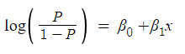
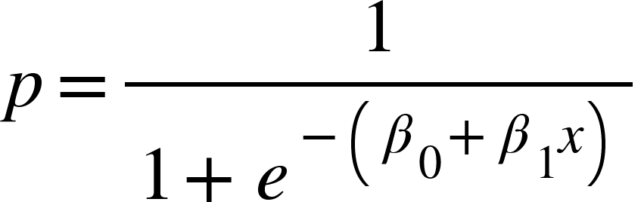
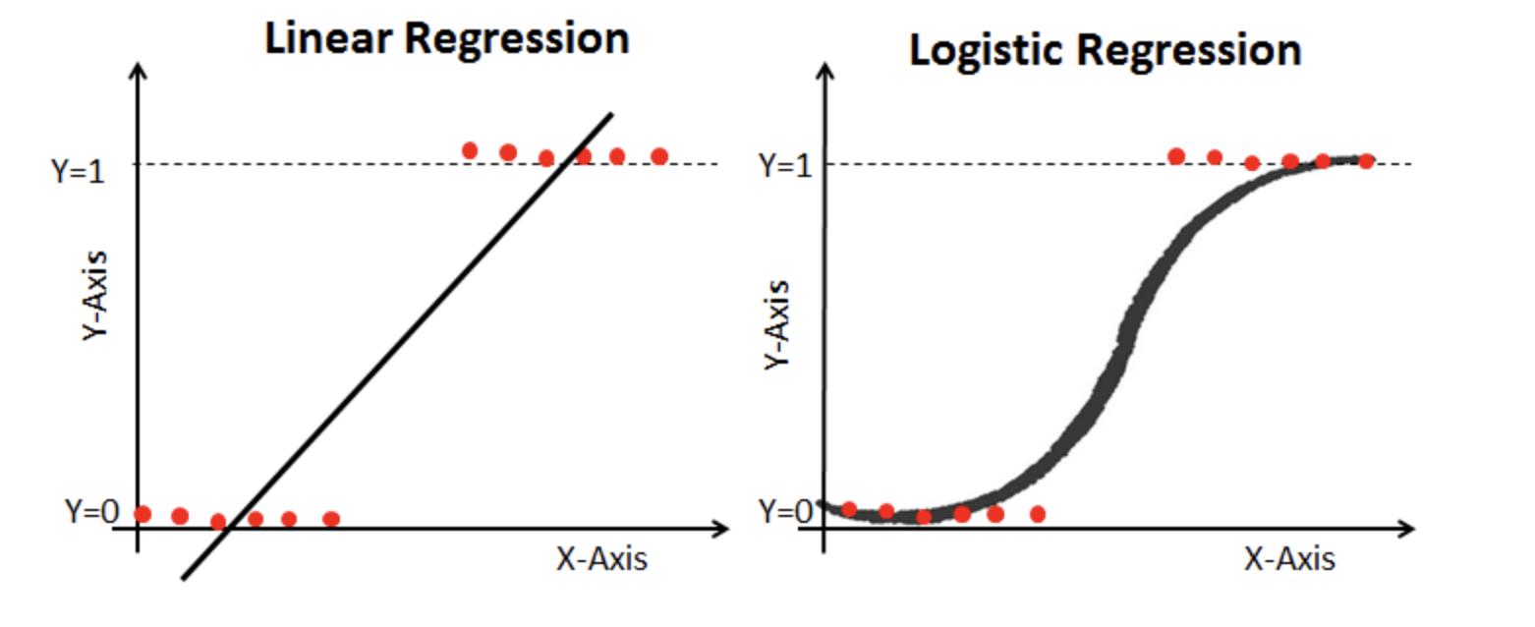
Logistic Regression Continued
Now, we have a log (odds) range from –inf..inf

Slide 4
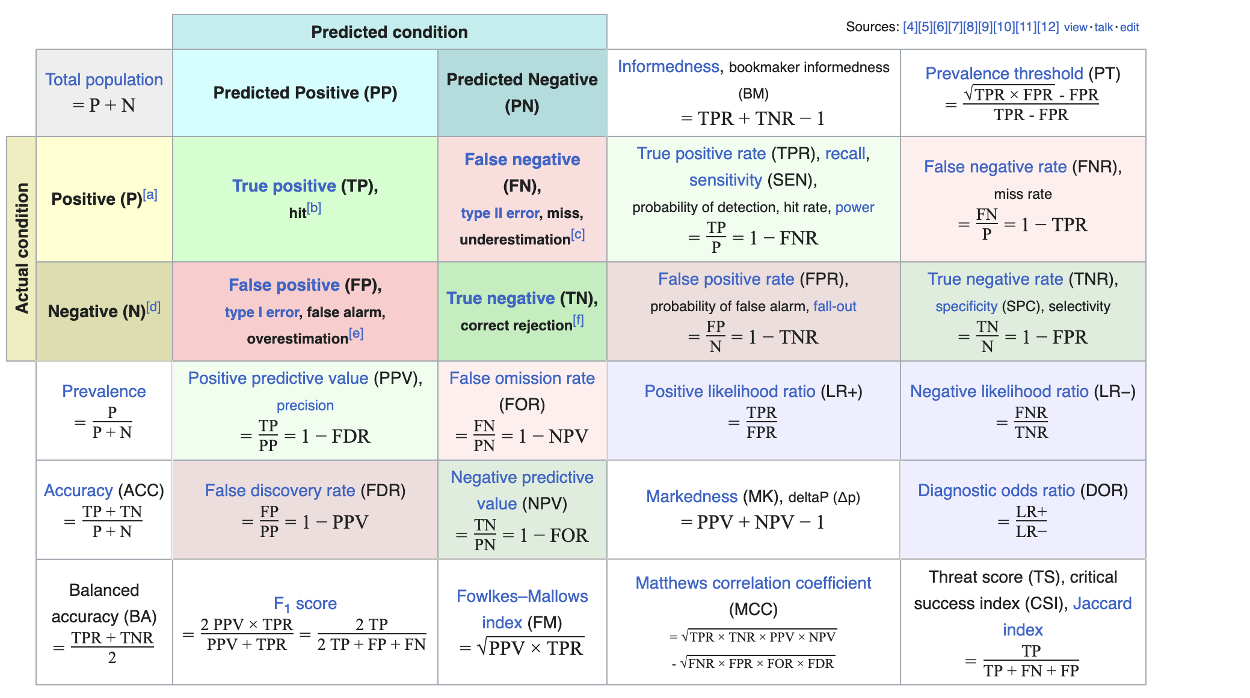
Confusion!
https://en.wikipedia.org/wiki/Precision_and_recall

Slide 5
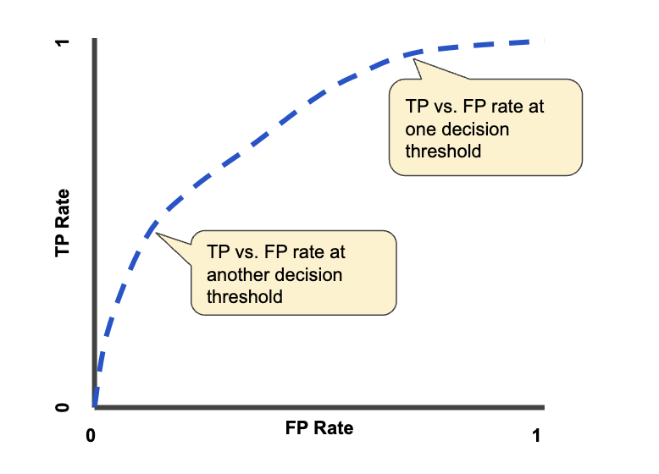
Receiver Operating Characteristic Curve(ROC)
AUC provides an aggregate measure of performance across all possible classification thresholds. One way of interpreting AUC is as the probability that the model ranks a random positive example more highly than a random negative example.
https://developers.google.com/machine-learning/crash-course/classification/roc-and-auc#:~:text=An%20ROC%20curve%20(receiver%20operating,False%20Positive%20Rate

Slide 6

Random Forest
Bootstrap Aggregating (Bagging): Random Forest starts by selecting random samples of the data for each tree via bootstrap (sampling with replacement). This process ensures that each tree is trained on a slightly different dataset.
Random Feature Selection: When building each tree, Random Forest randomly selects a subset of the features at each split instead of using the most significant feature. This randomness helps in making the trees less correlated and reduces overfitting.
Building Trees: Each tree in the forest is built to the largest extent possible (fully grown and unpruned), which allows the algorithm to capture complex patterns in the data.
Prediction:
For classification, the output is the mode of the classes predicted by individual trees.
For regression, it is the average prediction of the trees.

Slide 7
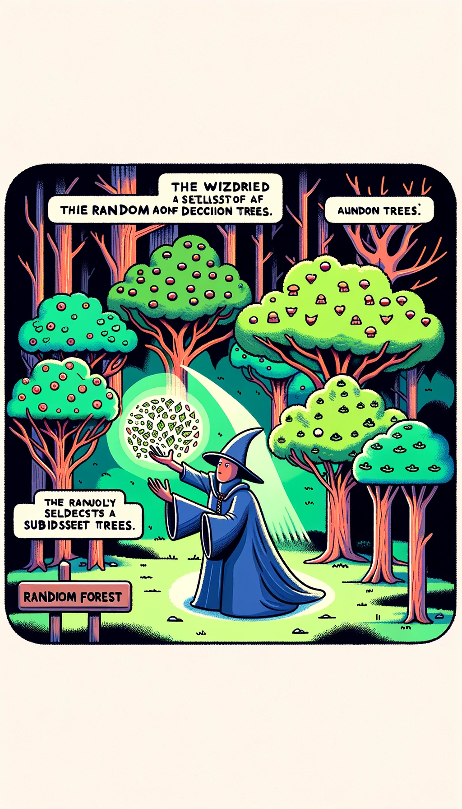

Slide 8
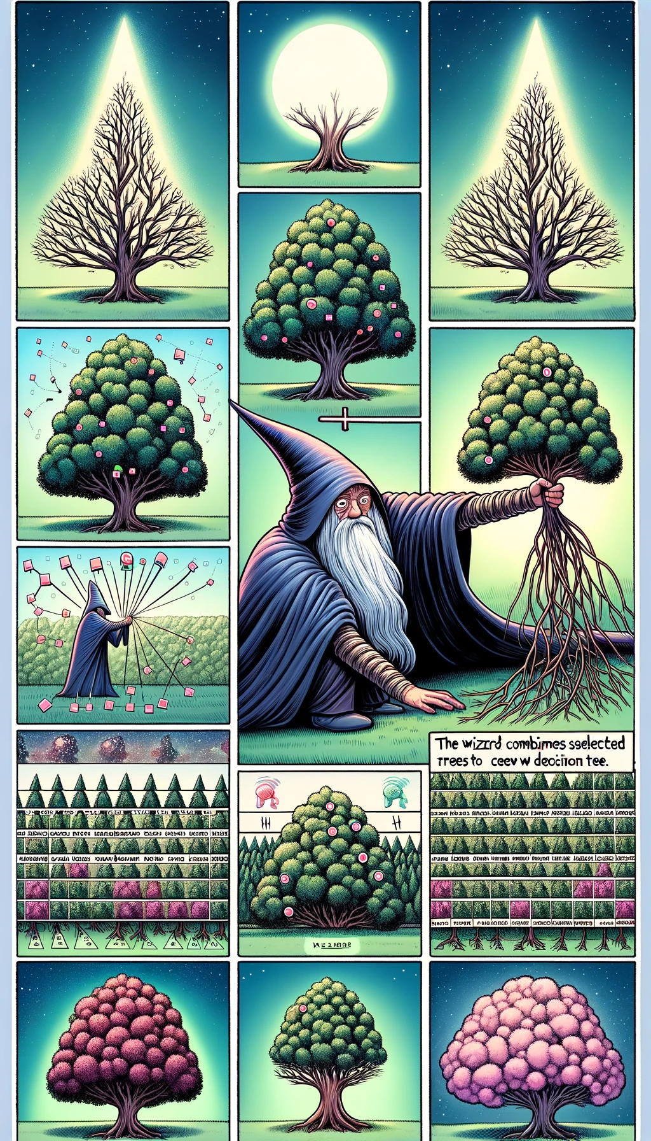

Slide 9


